Slide 1
Git Me Some Version Control
Ahmed Nawaz Khan

Slide 2
Buzz Words
Working Directory
Working Tree
Staging Area
Fork a branch
Set Upstream branch
HEAD
Interactive Rebasing

Slide 3
10Pearls Requisites
Make sure you have a github.com account using 10Pearls email address​
Your username should be in following format​
Example: ubaidbaig-10p​
If you don’t have one – sign-up Today​
Make sure you enable 2-factor authentication on github​
Once you enable 2-factor, you can use Personal Access Token (PAT) on command line​

Slide 4
Recap
Git add → Staging area → taking the snapshot
Git commit → Commit History → wrap all the snapshots and loading it onto the truck
Git push → truck leaving for centralized warehouse

Slide 5
Branching Strategies

Slide 6
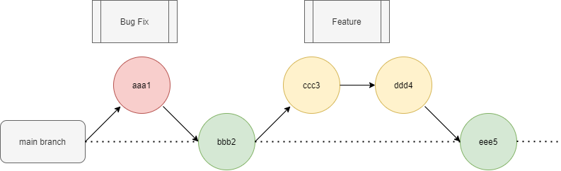
Branching Strategies ( Github Flow )

Slide 7
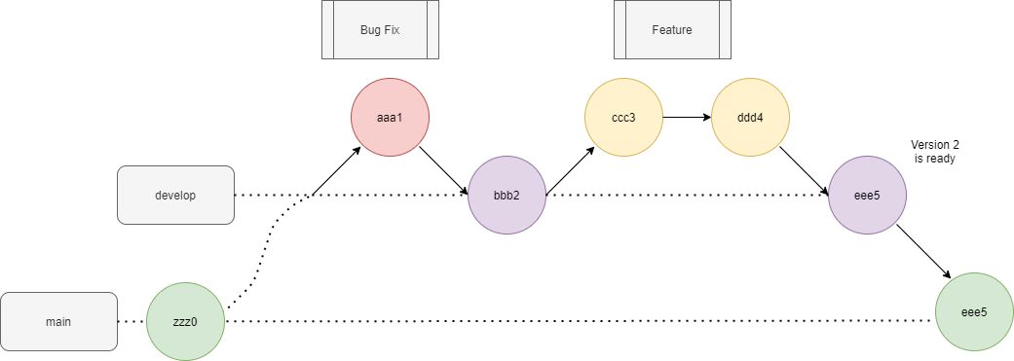
Branching Strategies ( Git Flow )

Slide 8
Standard Branches
master / main (now default branch in github.com)​
develop​
qa​
staging​
feat/JIRA-TICKET-NUMBER​
Bug/JIRA-TICKET-NUMBER​

Slide 9
Git Concepts

Slide 10
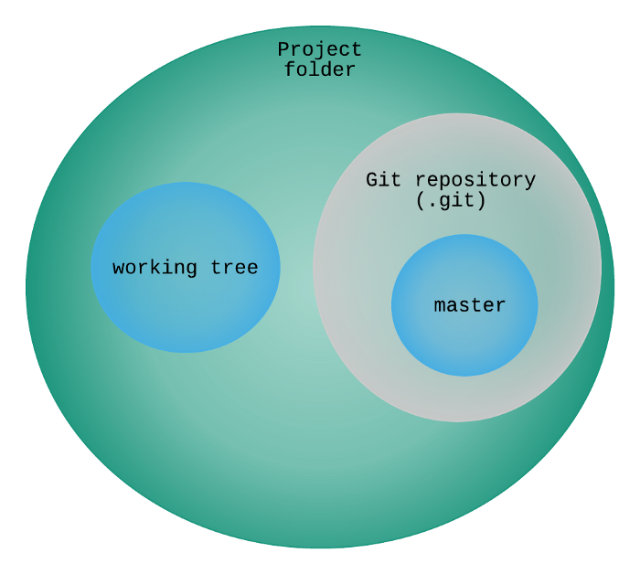
Working Directory/Tree
Adding a new file becomes part of the working tree
We can add multiple working trees as well

Slide 11
Set up
One time configuration
git config --global user.name ‘Your Name’​
git config --global user.email ‘Your Email’​
git config --global core.editor ‘vim’​

Slide 12
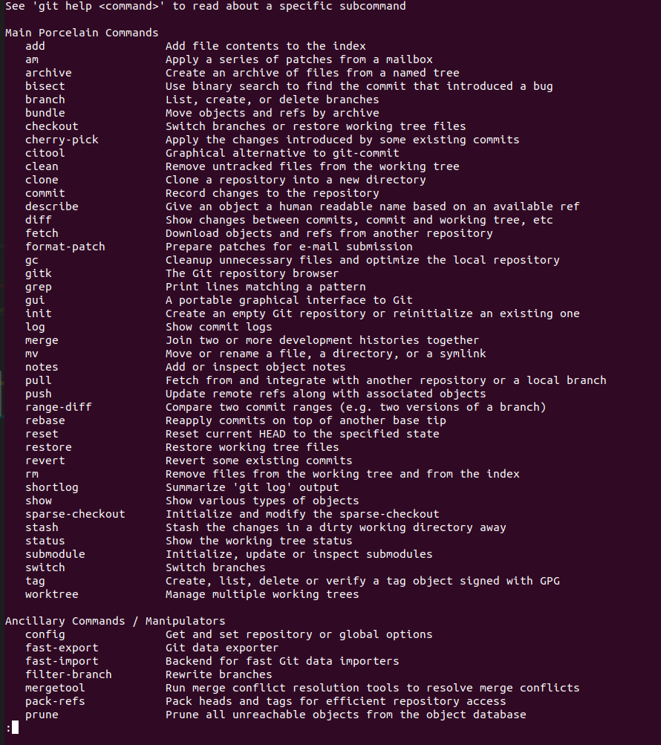
What is there in GIT
git help -a
We will be good if we know only 10% of these git commands

Slide 13
Common Commands
git init​
git remote add origin ‘your_github_repository_url’​​
git remote -v​
git status​
git add .​ ( a file in staging area is recoverable )
git commit -m ‘Initial Commit’​
git merge ( --abort )
git rebase ( --abort )
git stash ( git stash pop )
git checkout ( -b )
git push​ ( -u )
git log
git pull
git fetch
git clone
git branch -a
git reflog
git reset ( hard or soft )
We will be good if we know only 10% of total git commands

Slide 14
Merge Vs Rebase

Slide 15
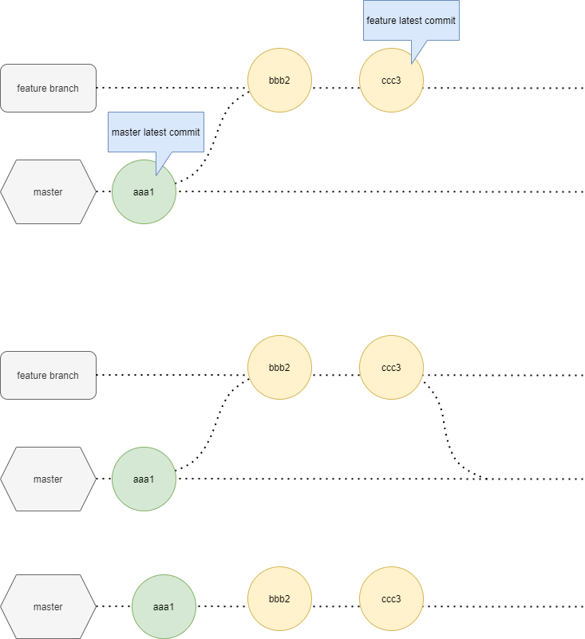
Fast Forward Merge
No new merge commit will be added

Slide 16
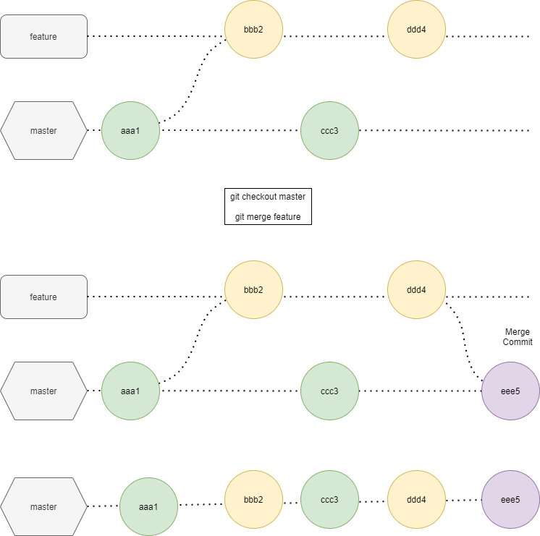
Common Merge
New merge will be added

Slide 17
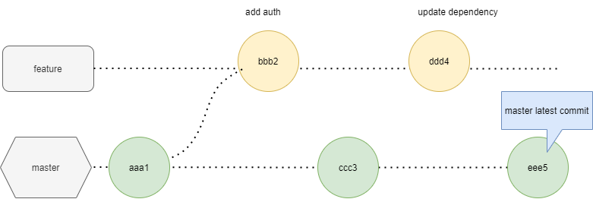
Rebase
IT IS NOT BETTER THAN MERGE

Slide 18
Rebase
commits are replayed on top of other
git checkout feature
git rebase master

Slide 19
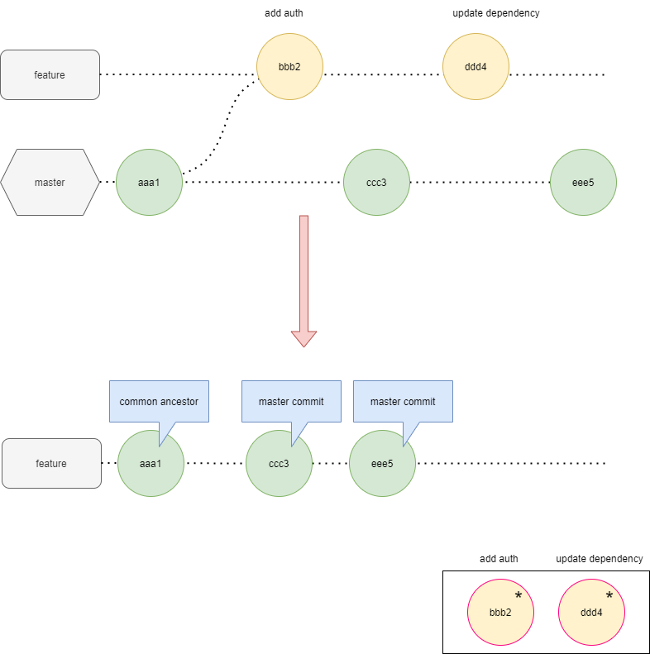
Rebase
commits are replayed on top of other

Slide 20
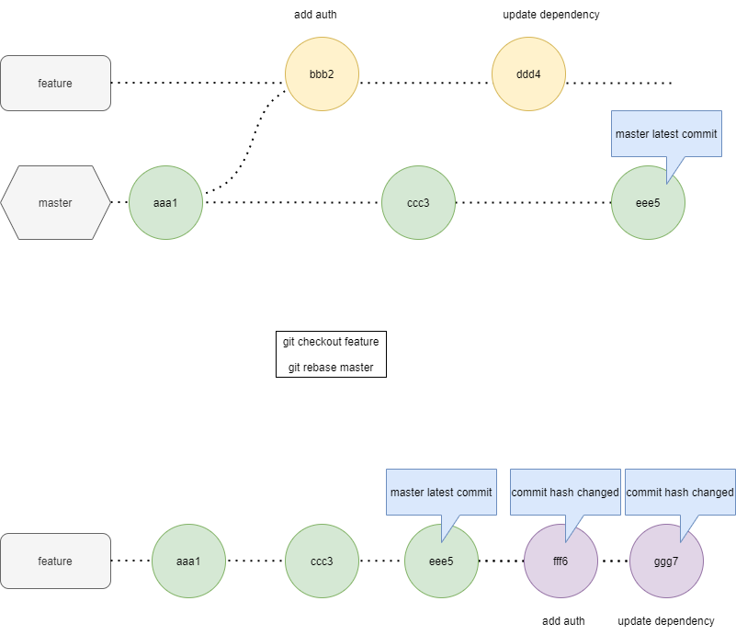
Rebase
REWINDING HEAD TO REPLAY YOUR WORK ON TOP OF IT
Now ready for fast forward merge
git checkout master
git merge feature

Slide 21
Interactive Rebasing

Slide 22
Bucket List
Git worktree

Slide 23
Inspiration
Jeffrey Way
Tobias Gunther ( freeCodeCamp )
Tim Berglund

Slide 24

Thanks!
ahmed.nawaz@10pearls.com

Slide 25
Questions ?

